Slide 1


08
Mathematics Model of Mixed Strategy
Samuel Lukas
A Guide to Game Theory by Fiona Carmichael, Prentice Hall, 2005
Introduction Game Theory and Its Applications
Elliott Mendelson, CRC Press Company, Washington DC.2004

Slide 2
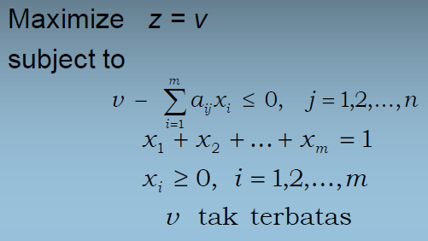
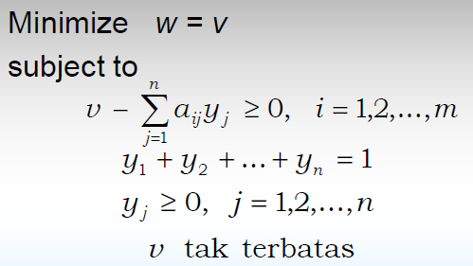
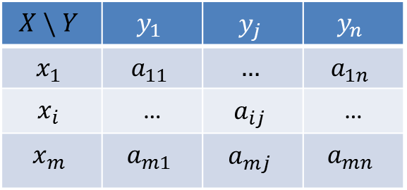
Mathematics Model
$$X \backslash Y$$ | $$y_{1}$$ | $$y_{j}$$ | $$y_{n}$$
$$x_{1}$$ | $$a_{11}$$ | $$…$$ | $$a_{1n}$$
$$x_{i}$$ | … | $$a_{ij}$$ | …
$$x_{m}$$ | $$a_{m1}$$ | $$a_{mj}$$ | $$a_{mn}$$
Problem A
Problem B
That is a dual problem betwen Problem A and B

Slide 3
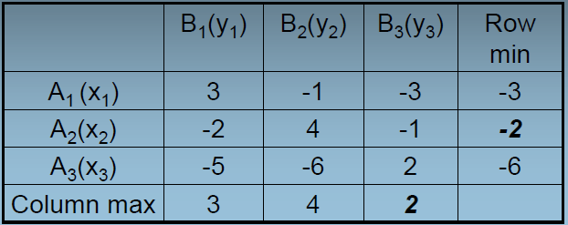
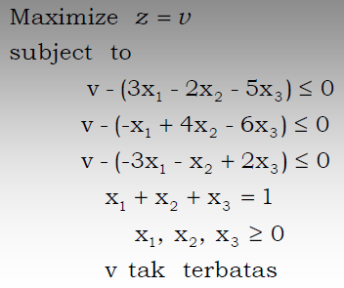
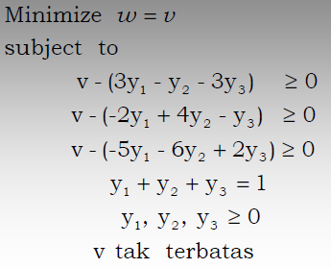

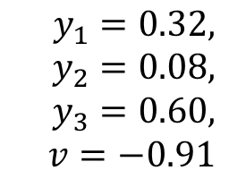
Example 01
Value of the game is
$$−2≤v≤2$$
$$x_{1}=0.39, x_{2}=0.31, x_{3}=0.29, v=−0.91$$
$$y_{1}=0.32, y_{2}=0.08, y_{3}=0.60, v=−0.91$$

Slide 4
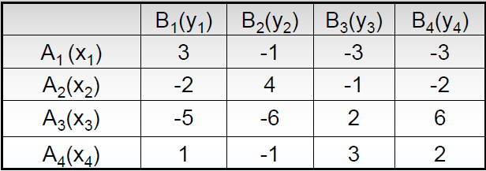
Exercise 01

Slide 5
Hawks and Dove are two patterns of animal behavior. Hawks are aggressive and prefer to fight while doves are more peaceful and not to fight. They share a resources for survival such as food. Determine the percentage of the population of hawk and dove so that the system is stable, if the pay-off matrix is given below.
A \ B | Hawk | Dove
Hawk | -4 , -4 | 12 , 0
Dove | 0 , 12 | 6 , 6
If 100% hawk than hawk will lost -4 of resources because they fight each other to get the resource.
If 100% dove than the source will be share to the dove 6 units each, It is not stable either. But if there is one hawk exist then the hawk will invade the population by reproduce faster than the doves.
The question is how many percentage of hawk and dove are there so that the population is stable?

Slide 6
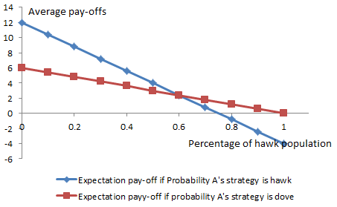



$$μ\left(x_{1}\right)=x \left(−4\right)+\left(1−x\right)12=v_{1}$$
$$μ\left(x_{1}\right)=μ\left(x_{2}\right)=v → x=0.6$$
$$μ\left(x_{2}\right)=x \left(0\right)+\left(1−x\right)\left(6\right)=v_{2}$$
If percentage of hawk population is higher then 0.6, it means population of hawk is higher, than Average-pay off hawk is less then average pay-off dove, consequently doves reproduce faster than hawks. The other way around is also apply and system will stable if percentage of hawk is 0.6

Slide 7
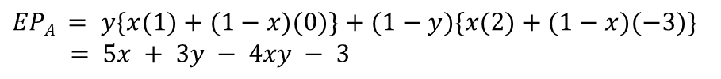
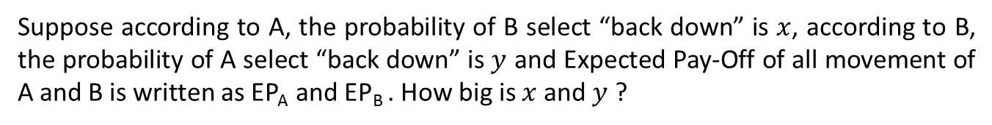
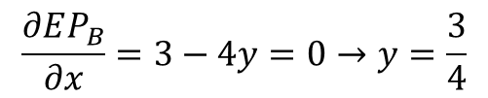
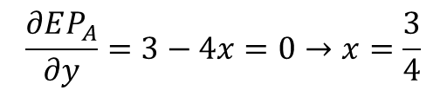
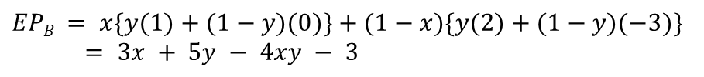
Mathematical strategy
Intuitive strategy is chosen by maximizing the expected value of each possibility movement. But mathematical strategy by maximizing the expected value of all possibility movements
Suppose according to A, the probability of B select “back down” is $x$, according to B, the probability of A select “back down” is $y$ and Expected Pay-Off of all movement of A and B is written as EP_{A} and EP_{B} . How big is $x$ and $y$ ?
A \ B | Back down | Challenge
Back down | 1 , 1 | 0 , 2
Challenge | 2 , 0 | -3 , -3
$$EPA = y\{x(1)+(1−x)(0)\}+(1−y)\{x(2)+(1−x)(−3)\}$$
$= 5x + 3y − 4xy − 3$
$$EPB = x\{y(1)+(1−y)(0)\}+(1−x)\{y(2)+(1−y)(−3)\} = 3x + 5y − 4xy − 3$$
$$\frac{∂EP_{A}}{∂y}=3−4x=0→x=\frac{3}{4}$$
$$\frac{∂EP_{B}}{∂x}=3−4y=0→y=\frac{3}{4}$$
It means according to A the best strategy for B is “backdown” and according to B the best strategy for A is “backdown” therefore the Nast equilibrium is [backdown,backdown]

Slide 8
Exercise 01
Consider striker in penalty game has more pleasure by kicking to the left with pay-off matrix given below. What is the Nash equilibrium of this asymmetric penalty game ? What does it mean ?
Striker \ Goalkeeper | left | right
left | 0, 1 | 2 , 0
right | 1 , 0 | 0 , 1
What strategy of each player of this pay-off matrix game?
A \ B | St | Pa | Sc
Stone | 0 , 0 | -1 , 1 | 1 , -1
Paper | 1 , -1 | 0 , 0 | -1 , 1
Scissor | -1 , 1 | 1 , -1 | 0 , 0
A \ B | St | Pa | Sc
Stone | 0 , 0 | -1 , 2 | 1 , -1
Paper | 2 , -1 | 0 , 0 | -2 , 1
Scissor | -1 , 1 | 1 , -2 | 0 , 0

